Slide 1
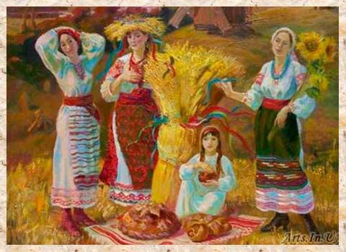
WELCOME TO RUSSIAN CLUB!!
We will begin shortly :)
Today’s topic: Harvest Festival (Обжинки)
https://youtu.be/xKQBmxEgEFM

Slide 2
Russian harvest festival history
Long before Europeans settled in North America, festivals of thanks and celebrations of harvest took place in Europe in the months of October and November.
In Russia a similar holiday exists called ‘Обжинки’, or Obzhynki; a Slavic harvest festival.
In pre-Christian times, the feast usually fell on or after the autumn equinox following the end of the harvest season.
The feast was initially associated with the pagan Slavic cult of plants, trees and agriculture.

Slide 3
Continued
In the 16th century in Central and Eastern Europe it gained a Christian character and started to be organized by the land gentry and more affluent peasants as a means to think the reapers and their families further for their work both during the harvest and during the year.
The celebration of plenty through food and good company.

Slide 4
Modern day celebrations
This is the biggest Moscow Seasons food event. The festival is to cover more than 1,500 venues around Moscow. This year, the event is going to be about innovations in agriculture.
Guests are in for a variety of farm products, original seasonal meals, folk concerts, lectures, workshops and more.
Red Square will be the largest Golden Autumn venue, with a real Russian field with cereals growing, a wild garden with trees and berries, a pasture with wooden sculptures of animals, and an apiary with real beehives and a mill.
https://www.mos.ru/en/news/item/62605073/

Slide 5
Traditions/ Rituals
The wreath is a central feature of most celebrations associated with it, as it symbolises a rich harvest, the prospect of wealth and the power of new life vested in the grain gathered during the Summer.
The latter probably explains why in many regions the grain from the wreath is used as the first batch of grain threshed and set aside for next year's sowing
Originally the wreath was in fact a decorated sheaf of grain, decorated with field flowers, ribbons and braided straws.
However, with time other forms of wreath became more popular, including the now-typical round wreath, but crown-shaped, oval or rectangular wreaths are also popular in various regions.

Slide 6
Continued
The sheaf or the wreath is usually brought back into the village by a ceremonial procession. It is often blessed, either by a Christian priest, or in an extra-religious way
By mid-August harvest grain ends, hence the name of the holiday. Includes the rituals associated with last (dozhinochnym) sheaf, the ritual of "curling beard" and a celebratory meal.
Almost lost in Russia at the Soviet period. In the post-Soviet period this folk tradition in some countries has been recreated as an official holiday.

Slide 7
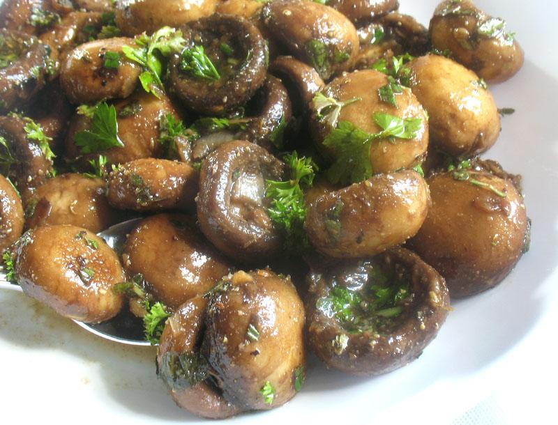
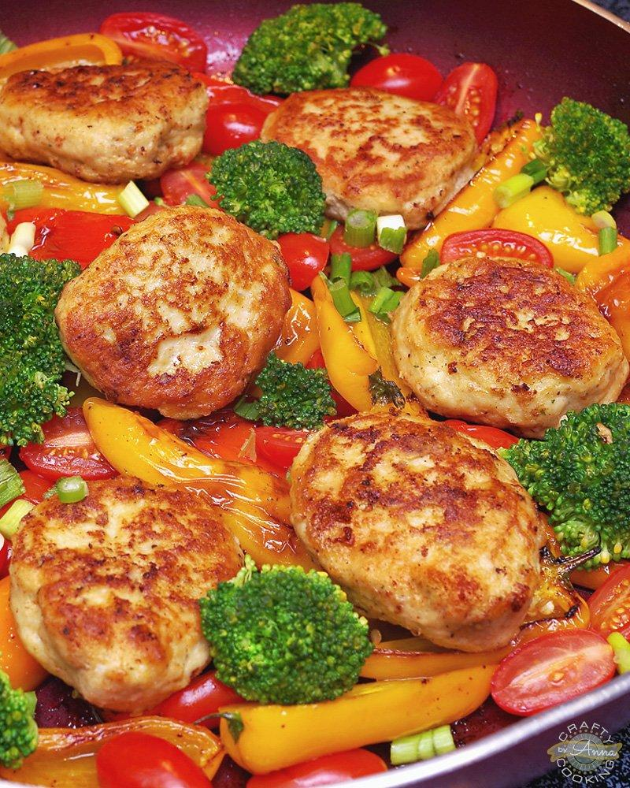
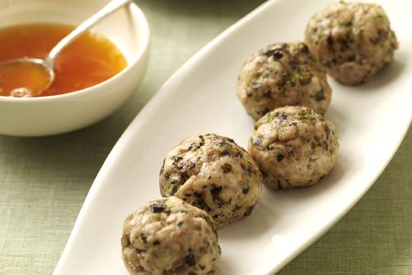
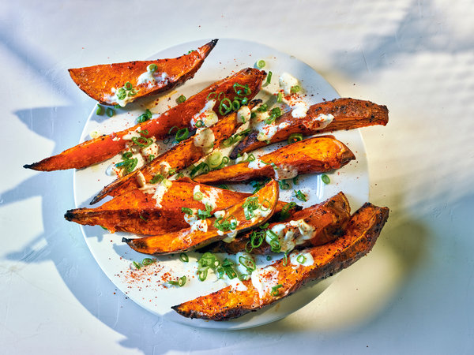
Foods
Fried Kotletki
Dry red and white Krasnodar wines
Steamed sliced yams
Traditionally marinated forest mushrooms
Various veggies like steamed broccoli and chopped steamed squash
Sautéed spuds
While this is different from the usual turkey these holiday meals are a delicious and festive Russian alternative

Slide 8
Recipes!!
Fried kotletki - https://natashaskitchen.com/chicken-kotleti-you-will-dream-about-recipe/
Yams- https://natashaskitchen.com/maple-roasted-sweet-potatoes-and-bacon/
Borscht- https://natashaskitchen.com/borscht-recipe-with-meat/
Syrniki - https://natashaskitchen.com/ukrainian-syrniki-recipe/
Pelmeni - https://natashaskitchen.com/russian-pelmeni-recipe-new-dough-recipe/

Slide 9
https://youtu.be/0ri6Fq2-EFU
https://youtu.be/M0aB6tLipRk

